Slide 1

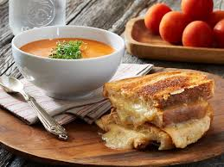
BI Mini Project Zomato Restaurant Rating Analysis

Slide 2
Table of Contents
Introduction

Slide 3
INTRODUCTION
The culinary in India is as varied as its culture. On every 10 kilometers of distance we find the variety in food. With increasing technology we order food online. Amongst all the food applications Zomato is one which is very widely used.
The purpose of this project is to analyze which restaurant is popular in a particular locality of a particular city. It collects the data on various attributes like City, Cuisines, rating in number, rating in text, Average cost of two person, availability of table and online booking. There are 13 prime cities of India, 226 restaurants with 28 different cuisines spread across 137 different localities of these cities.

Slide 4
Information about the Dataset
Restaurant ID - Identification Number
Restaurant Name - Name Of the Restaurant
Country Code 216
City - City Name of the Restaurant
Address
Cuisines - Types Of Cuisines Served
Average Cost for two - Average Cost if two people visit the Restaurant
Currency
Has Table booking - Can we book tables in Restaurant? Yes/No
Has Online delivery - Can we have online delivery ? Yes/No
Is delivering now - Is the Restaurant delivering food now? Yes/No
Price range - Categorized price between 1 -4
Aggregate rating - Categorizing ratings between 1-5
Rating text - Different Rating like Excellent, Very Good ,Good, Avg., Poor, Not Rated
Votes - No. Of Votes received by restaurant from customers.

Slide 5
Schema Design
The project follows the given schema :-
The Dimension tables are:-
City
This dimension contains information about the city on which the analysis will be carried out.
It comprises of the following fields:-
City_id
City_name
Country
This dimension contains information about the city on which the analysis will be carried out.
It comprises of the following fields:-
Country_id
Country_code
Cuisine
This dimension contains information about the city on which the analysis will be carried out.
It comprises of the following fields:-
Cuisine_id
Cuisine

Slide 6
Schema Design
Delivery
This dimension contains information about the city on which the analysis will be carried out.
It comprises of the following fields:-
Delivery_Id
Delivery_Facility
Delivery_Online_Now
Locality
This dimension contains information about the city on which the analysis will be carried out.
It comprises of the following fields:-
Locality_Id
Locality_Name
Rating_Star
This dimension contains information about the city on which the analysis will be carried out.
It comprises of the following fields:-
Rating_Star_Id
Rating_in_5

Slide 7
Schema Design
Rating_text
This dimension contains information about the city on which the analysis will be carried out.
It comprises of the following fields:-
Rating_text_id
Rating_in_text
Restaurant
This dimension contains information about the city on which the analysis will be carried out.
It comprises of the following fields:-
Restaurant_id
Restaurant_name
Table_booking
This dimension contains information about the city on which the analysis will be carried out.
It comprises of the following fields:-
Table_Booking_id
Table_Booking_avail

Slide 8
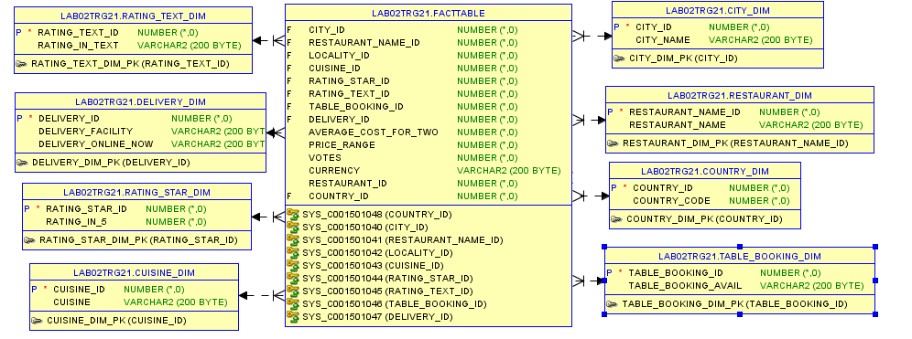
DATA MODEL

Slide 9


Analyzing Data
Various analysis tools are available in the market for the analysis.
Data being big , we have use Apache Hive Framework.
Hive uses HQL (Hive Query Language) to retrieve data from large datasets.
Fast and Efficient , uses Map-Reduce Paradigm in background.

Slide 10
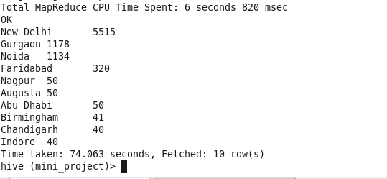
Data Analysis and Results
Top 10 count of Restaurant City Wise
Over 80% of the observations belong to restaurants in Delhi , Gurgaon and Noida

Slide 11
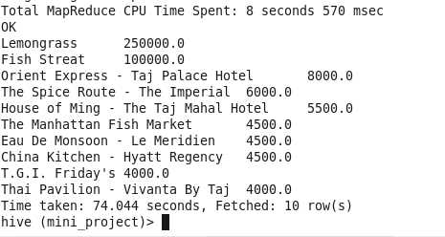
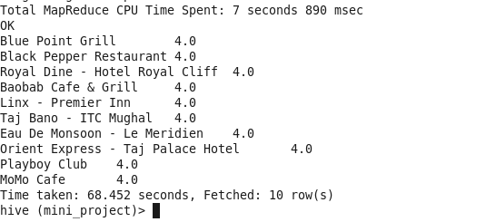
Top 10 restaurant based on Average Cost for Two
Top 10 restaurant based on Price range

Slide 12
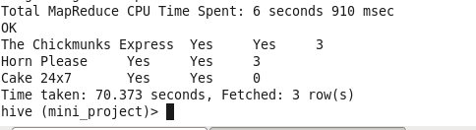
Top 10 restaurant based on Price range
Highest Aggregate Rating Restaurant having Online Delivery and is
Delivering now

